Slide 1
INTRODUCTION TO AWS
PRESENTED BY:-PRADEEP KARAKAL
USN:-2BA24MCO23
MCA-2ND SEMESTER

Slide 2

Introduction to AWS
AWS (Amazon Web Services) is Amazon’s secure and comprehensive cloud computing platform.
It was officially launched in 2006, pioneering the modern cloud computing era.
AWS offers over 200 fully managed cloud services across various domains.
It replaces upfront infrastructure costs with on-demand, pay-as-you-go access.
Millions of businesses, startups, and governments rely on AWS worldwide.
AWS enables rapid innovation through scalable and flexible resources.
It supports global operations with a vast, reliable infrastructure.

Slide 3
AWS: History & Evolution
1. AWS began with core services like S3 (storage) and EC2 (compute).
2. Over time, it rapidly expanded to include databases, AI, IoT, and analytics.
3. It now has a massive global footprint with multiple Regions and Availability Zones.
4. AWS introduced groundbreaking services like serverless computing (Lambda).
5. It set industry standards for secure, reliable, scalable cloud computing.
6. AWS generates significant revenue for Amazon’s overall business.
7. The platform keeps evolving with new tools and constant innovation.

Slide 4
Why Organizations Choose AWS
AWS provides high scalability to handle varying workloads.
It ensures reliable performance with global multi-region redundancy.
Customers benefit from a global network for faster delivery worldwide.
AWS meets stringent security and compliance standards.
Pay-as-you-go pricing helps avoid upfront capital expenses.
A vast ecosystem of tools and partners extends functionality.
Continuous innovation keeps customers competitive in the market.

Slide 5

AWS Global Infrastructure
AWS Regions are geographic clusters of physical data centers.
Availability Zones (AZs) provide fault tolerance and high availability.
Edge Locations cache content closer to end users for low latency.
Local Zones extend AWS services near large cities..
CloudFront accelerates global content delivery securely.
The infrastructure supports DR, compliance, and global scaling.

Slide 6
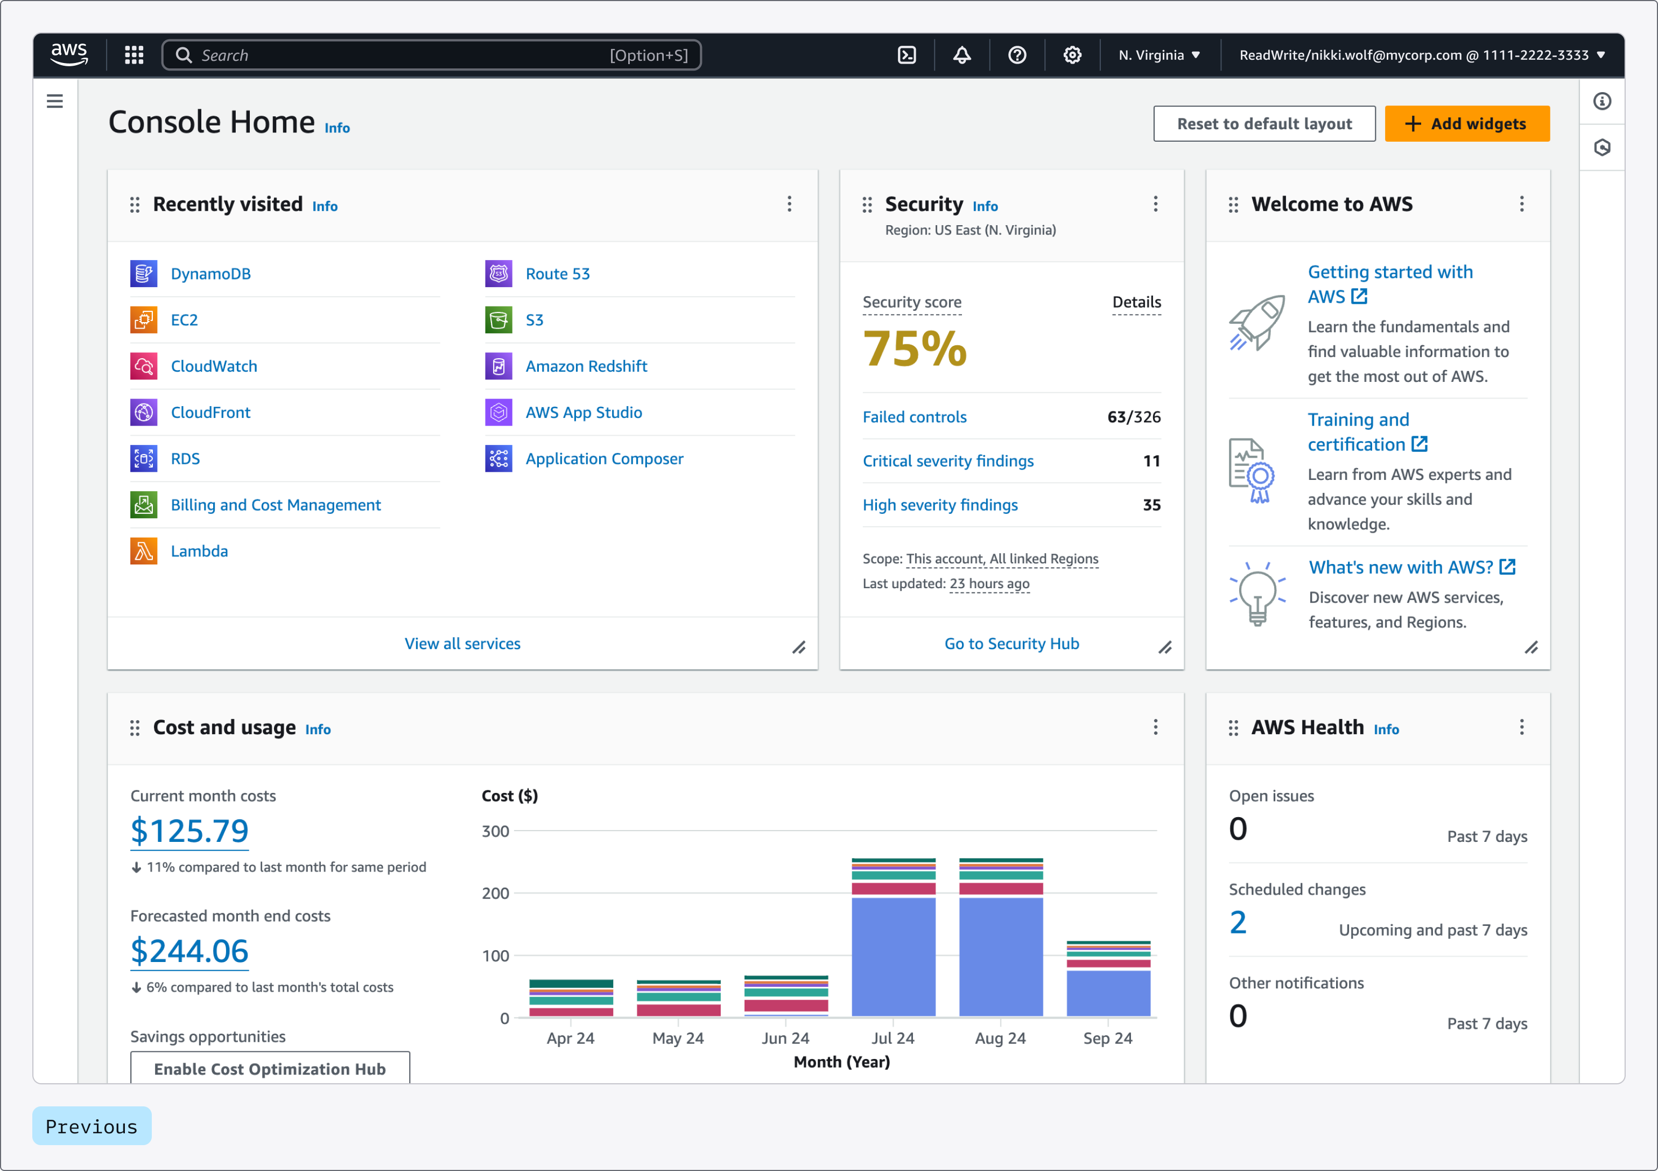
AWS INTERFACE

Slide 7
Core AWS Services Overview
1. EC2 offers elastic virtual servers for flexible compute workloads.
2. S3 provides secure, durable, and scalable object storage.
3. RDS manages relational databases with automation and scaling.
4. Lambda lets you run code without managing servers.
5. VPC allows you to isolate resources securely within a network.
6. CloudFront delivers content globally with low latency.
7. IAM controls user identities, roles, and resource permissions.

Slide 8

Amazon Elastic compute cloud (EC2)
EC2 provides resizable virtual computing capacity in the cloud.
Offers various instance types to match different workload needs.
Amazon Machine Images (AMIs) simplify launching preconfigured servers.
Auto Scaling dynamically adjusts instance counts based on demand.
Elastic Load Balancing distributes traffic for high availability.
Works with VPC for secure networking and firewall controls.
Used for hosting websites, apps, gaming servers, and development.

Slide 9

Amazon Simple storage service (S3)
Amazon S3 offers industry-leading durability and availability for data.
Stores data in buckets and objects with virtually unlimited capacity.
Lifecycle policies help automate data movement and storage cost control.
Versioning preserves, retrieves, and restores every version of an object.
Integrated with CloudFront for static website hosting and distribution.
Supports encryption and IAM policies for secure access control.
Used for backups, big data, media storage, and disaster recovery.

Slide 10
Amazon Simple storage service (S3)
Amazon S3 offers industry-leading durability and availability for data.
Stores data in buckets and objects with virtually unlimited capacity.
Lifecycle policies help automate data movement and storage cost control.
Versioning preserves, retrieves, and restores every version of an object.
Integrated with CloudFront for static website hosting and distribution.
Supports encryption and IAM policies for secure access control.
Used for backups, big data, media storage, and disaster recovery.

Slide 11
Amazon RDS
Amazon RDS simplifies setting up and operating relational databases.
Supports engines like MySQL, PostgreSQL, Oracle, SQL Server, and MariaDB.
Handles backups, software patching, and automatic failover.
Multi-AZ deployment ensures high availability and data durability.
Read Replicas help scale out read-heavy database workloads.
Provides encryption for data at rest and in transit for compliance.
Ideal for web apps, ERP systems, and enterprise applications.

Slide 12
AWS Lambda
AWS Lambda is a serverless compute service that runs code in response to events.
It automatically scales up to match the workload and scales to zero when idle.
Supports multiple programming languages like Python, Node.js, Java, and C#.
Charges only for compute time, with no charges when the code is not running.
Seamlessly integrates with other AWS services and third-party APIs.
Commonly used for automation, API backends, and real-time data processing.

Slide 13

AWS Identity & Access Management (IAM)
IAM controls access to AWS services and resources securely.
Creates and manages AWS users, groups, and permissions.
IAM policies define allowed or denied actions on resources.
Multi-Factor Authentication (MFA) adds an extra security layer.
AWS Organizations help manage multiple accounts centrally.
IAM integrates with CloudTrail for activity logging and auditing.
Best practices recommend least-privilege permissions.

Slide 14
Cost Management
Pay-as-you-go pricing avoids upfront hardware costs.
AWS Free Tier allows testing services at no initial cost.
Savings Plans and Reserved Instances provide significant discounts.
Cost Explorer visualizes usage patterns and spending trends.
Budgets track costs and forecast expenses with alerts.
Detailed billing reports and tags help allocate costs.
Trusted Advisor helps identify underused resources for optimization.

Slide 15

Use Case: Web Hosting
EC2 instances host dynamic applications and backend services.
S3 stores and serves static files like images and scripts.
Route 53 provides highly available DNS and domain registration.
Elastic Load Balancing distributes incoming traffic evenly.
Auto Scaling adjusts capacity during traffic spikes automatically.
CloudFront delivers web content securely and quickly to users worldwide.

Slide 16
Use Case: Backup & Recovery
S3 provides highly durable storage for regular backups.
Cross-region replication ensures data redundancy across geographies.
Lifecycle rules automate movement to cheaper storage tiers.
Backup Vaults manage policies and schedules efficiently.
Encryption protects sensitive backup data at all stages.
Supports compliance and regulatory requirements for data retention.

Slide 17
Use Case: Big Data & Analytics
EMR simplifies big data processing using Hadoop, Spark, and Hive.
Redshift offers a scalable, fast cloud data warehouse solution.
handles real-time data streaming and analytics.
Glue automates ETL workflows for structured and unstructured data.
Athena queries data in S3 directly using standard SQL.
QuickSight provides business intelligence dashboards and reports.

Slide 18
References
AWS Official Website: https://aws.amazon.com
- AWS Documentation: https://docs.aws.amazon.com
-AWS Training and Certification:https://aws.amazon.com/training
- YouTube: AWS Events and Tutorials
- Cloud Academy and Coursera: AWS Cloud Courses

